Slide 1
ASHRAE - Great Energy Predictor III
Jakesh Bohaju
Salit Dangol
Fusemachines AI Centre
17th January 2020

Slide 2
Introduction
American Society of Heating, Refrigerating and Air-Conditioning Engineers, ASHRAE a global society advancing human well-being
Dr. Miller plans third competition
ASHRAE Predictor Shootout I (1993) and Predictor Shootout II (1995)
Provide five dataset: building_meta, train, weather_train, test and weather_test
CatBoost, Light gbm and neural network are favorite model

Slide 3
Project Goals
Implement machine learning model
Best model for predicting meter reading

Slide 4
Proposed Solution
Extracting top features
Fit to the machine learning model
Predict for validation and test dataset

Slide 5
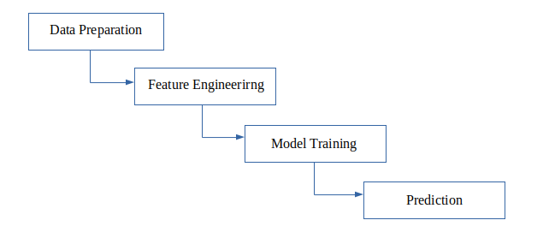
Implementation
Figure : Project workflow

Slide 6
Implementation
Data preparation
  Impute missing data
  Merge dataframe
Feature engineering
  Encode categorical data
  Transformation data
  Logarithmic scaling

Slide 7
Implementation
Model Training
  Linear regression
  Light GBM
Prediction

Slide 8
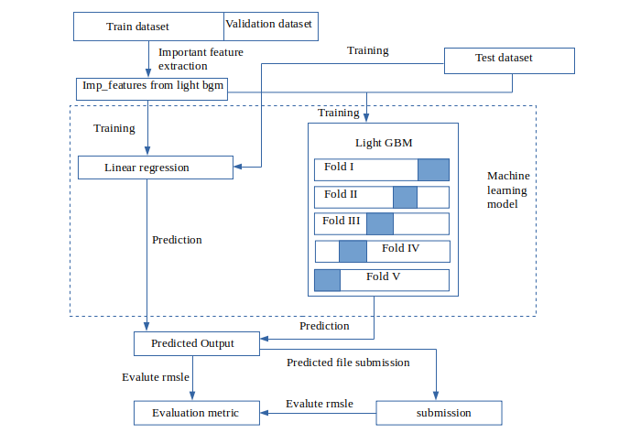
Implemented Model
Figure : Implementation of model

Slide 9
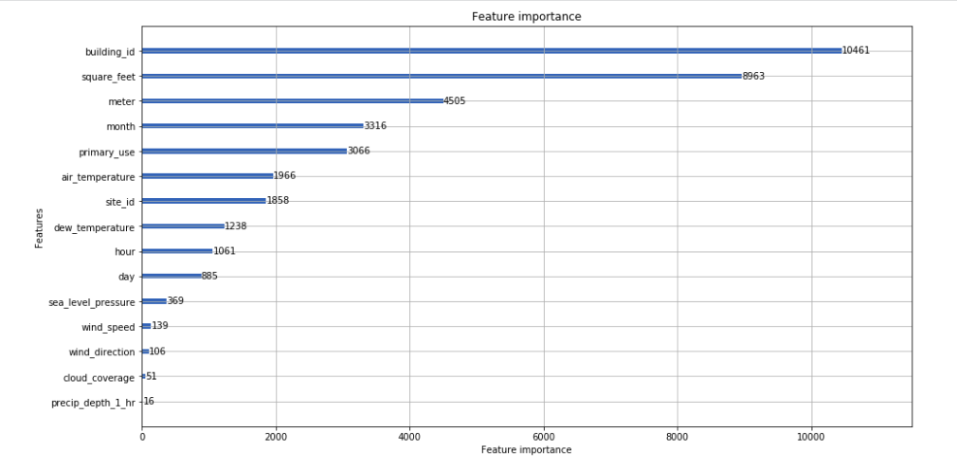
Figure : Selection of important feature

Slide 10
Problem Faced
Limited time
Memory usage

Slide 11
Result
53.42% year built and 75.50% floor count missing data
10 important feature among 15 features
building_id, square_feet, meter, month, primary_use, air_temperature, site_id, dew_temperature, hour, day
Evaluation metric rmsle
  linear regression : 7.79296
  light gbm : 5.51339
Kaggle score
  linear regression : 2.191
  light gbm : 2.050

Slide 12
Conclusion
Split 4:1 train and validation set
Select top ten important feature
Apply two machine learning model
Prediction and submission

Slide 13
Thank you

